Slide 1
Data Science Salary Analysis & Recommendations
By Peter Jordan

Slide 2
Introduction & Objective
Purpose of the Analysis:
Our company plans to hire a full-time Data Scientist to lead data-driven decision-making.
The goal is to determine a competitive salary range to attract and retain top talent.
The position may be U.S.-based or offshore, with consideration for remote and hybrid work flexibility to optimize cost and talent availability.
Key Questions:
What is the typical salary range for core data science roles?
How do experience levels and company size influence pay?
What is the difference between U.S. and non-U.S. salaries?
How does remote flexibility impact compensation?
What would be a realistic and competitive range for a small but growing company?

Slide 3
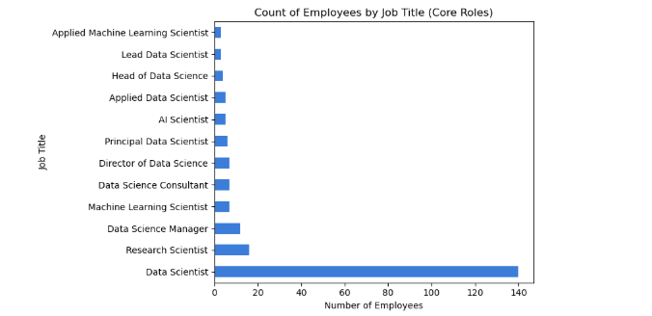
Data Selection & Filtering
Purpose: To align the analysis with the CEO’s hiring goal — identifying fair and competitive pay for a full-time Data Scientist who can drive data strategy and potentially lead a team as the company grows.
Approach:
Started with 607 total records from global data roles.
Filtered to core data science titles most relevant to this hire:
Data Scientist, Lead/Principal Data Scientist, Data Science Manager, Director/Head of Data Science, AI Scientist, Machine Learning Scientist, Applied Data Scientist, Research Scientist, Consultant.
Excluded engineering- and analytics-oriented titles (e.g., Data Engineer, BI Analyst, Marketing Data Analyst, Data Architect) to maintain a focused view on modeling and AI/ML work.
Rationale:
These core roles involve model building, experimentation, and advanced analytics, not just reporting or infrastructure.
Leadership titles in this subset reflect the career path of a Data Scientist moving into management — aligning with the CEO’s long-term vision.
Including unrelated roles would skew salaries downward and dilute relevance to the position being filled.
Key Outcome:
A refined subset of 215 relevant records that best represents the market for a leadership-track Data Scientist — the type of candidate who can establish and scale data science within a growing organization.

Slide 4
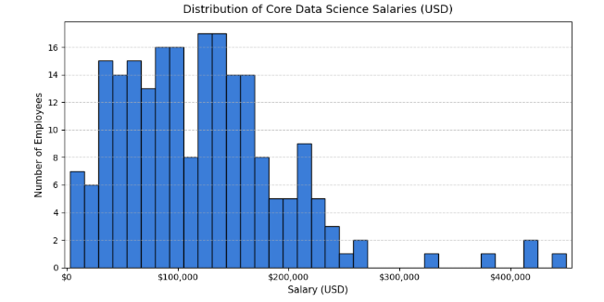
Overall Salary Overview
Key Insights
The majority of salaries fall between $60,000 and $180,000, representing the main market range for data science professionals.
Salaries are right-skewed, with a few high-end positions earning above $250,000.
The most common pay range is $100,000–$150,000, typical for mid- to senior-level data scientists.
Outliers above $300,000 likely correspond to Director or Head of Data Science roles at larger organizations.
Overall, the $100K–$150K range reflects the core competitive benchmark for hiring a qualified, full-time Data Scientist.

Slide 5
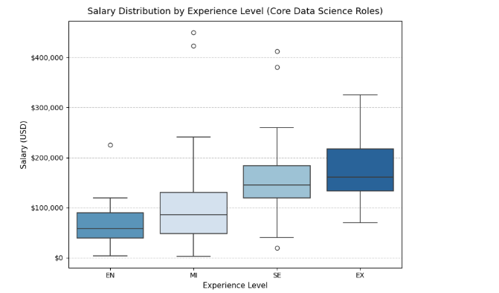
Salaries by Experience Level
Experience Level & Compensation
Key Insights:
Salaries rise steadily with experience
Entry-level median: ≈ $58K
Mid-level median: ≈ $85K
Senior-level median: ≈ $145K
Executive-level median: ≈ $160K+
Takeaway:
Salary progression follows a clear experience curve — mid to senior levels represent the most competitive range for our target hire.

Slide 6
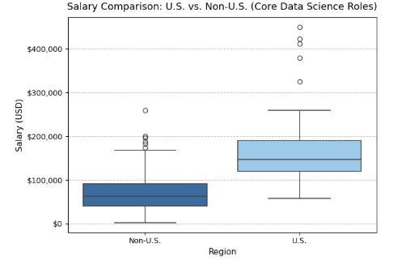
U.S. vs. Non-U.S. Data Science Salaries
Key Insights:
U.S. median: ≈ $147K | Non-U.S. median: ≈ $63K
U.S. salaries are more than double Non-U.S. levels on average.
Greater salary variation in U.S. roles reflects wider range of seniority and organization size.
Non-U.S. salaries cluster lower, with few high-earning exceptions.
Takeaway:
U.S.-based hires demand higher investment (≈ $130K–$170K) but provide stronger market alignment, collaboration, and leadership potential for a growing U.S. company.

Slide 7
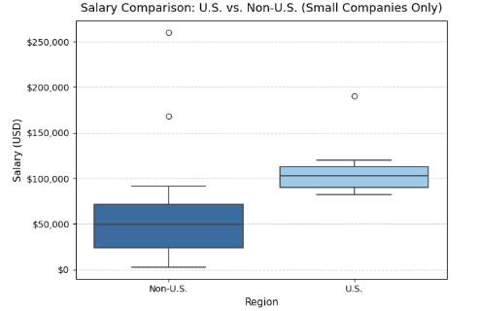
U.S. vs. Non-U.S Small-Company Salaries
Key Insights:
U.S. median: ≈ $102K | Non-U.S. median: ≈ $50K
U.S. small-firm salaries are roughly double Non-U.S. levels.
U.S. range: $90K – $130K (typical) | Non-U.S.: $50K – $80K (typical)
Non-U.S. firms show wider variability with a few high outliers.
Takeaway:
For a small but growing company, a U.S. Data Scientist typically earns $100K – $120K, while comparable offshore roles average $50K – $80K.
U.S. salaries remain the benchmark for attracting top-tier, full-time data science talent.

Slide 8
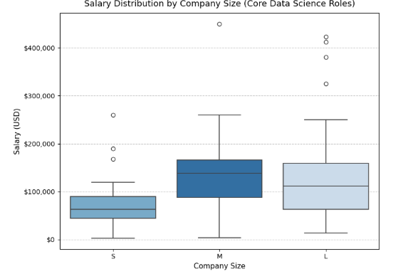
Salary by Company Size
Key Insights:
Small firms (S): Median ≈ $63K — lowest pay, focused on generalist roles.
Medium firms (M): Median ≈ $138K — sharp rise as firms invest in skilled talent.
Large firms (L): Median ≈ $111K — broad range due to mix of junior & senior roles.
Pay generally rises with company size, but variation widens in larger orgs.
Takeaway:
For a small but growing company, offering $100K–$130K is competitive — bridging small-company cost efficiency with mid-company talent quality.

Slide 9
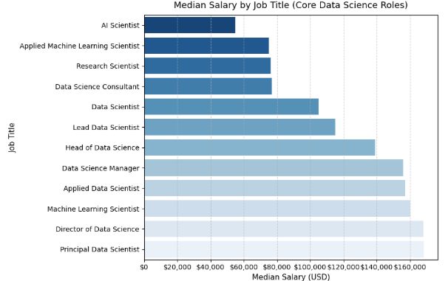
Salary by Job Title
Key Insights:
Top leadership roles (Principal & Director of Data Science): $150K–$160K median.
Mid–senior roles (Manager, Head, Lead): $120K–$140K range.
Data Scientist: ~$110K median — balanced between skill depth and affordability.
Research & Applied roles trend lower (~$70K–$90K), reflecting narrower specialization.
Takeaway:
A Data Scientist salary of $110K–$130K is both competitive and sustainable, positioning the company to attract strong technical talent while maintaining fiscal balance.

Slide 10
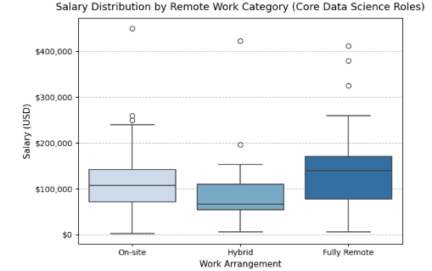
Salary by Remote Work Category
Key Insights:
Fully Remote: Highest median (~$140K), driven by U.S.-based remote professionals.
On-site: Median around $107K, with wide variation due to executive roles.
Hybrid: Lowest median (~$67K–$90K), reflecting more cost-optimized positions.
Salary differences suggest location and company policy influence pay more than flexibility alone.
Takeaway:
A U.S.-based remote or hybrid model offers the best balance of cost, flexibility, and access to high-performing data science talent.

Slide 11
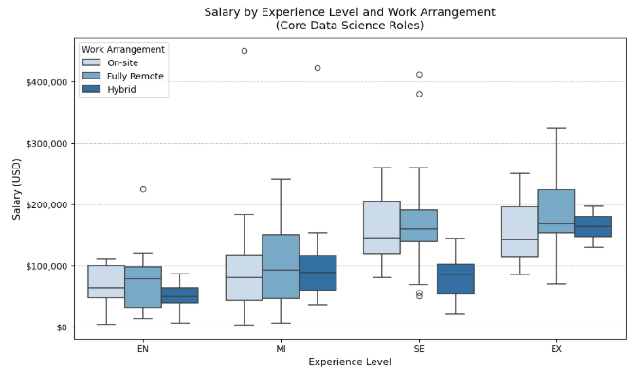
Experience Level × Remote Work
Key Insights:
Salaries increase predictably with experience, across all work arrangements.
Fully Remote roles often earn equal or higher pay than on-site, particularly at senior (SE) and executive (EX) levels.
Entry-level: Remote ≈ $75K–$80K | Hybrid ≈ $50K
Mid-level: Median around $90K–$100K
Senior-level: Fully remote ≈ $160K median, showing employers reward experienced remote professionals.
Executive-level: Consistent pay across arrangements ($140K–$170K range).
Takeaway:
Salary growth strongly tracks experience. At senior levels, remote flexibility no longer reduces earning potential — it may even enhance it.
A senior fully remote or hybrid U.S.-based hire (~$140K–$160K) represents the ideal blend of expertise, flexibility, and value for the company’s next data science leader.

Slide 12
Final Recommendation to the CEO
Summary of Key Insights
U.S. vs. Non-U.S. Pay Gap:
U.S. median ≈ $147K vs. Non-U.S. ≈ $63K, reflecting market competitiveness and cost-of-living differences.
Experience:
Salaries rise steadily with experience — from $65K (Entry) to $180K+ (Executive).
The steepest jump occurs between Mid-level and Senior-level roles.
Company Size:
Small firms average ~$72K, while medium and large firms exceed $120K, showing that scaling organizations pay more for expertise.
Remote Flexibility:
Fully remote senior roles command equal or higher pay than on-site, confirming remote work is now mainstream — not a discount factor.
Recommended Salary Range
U.S.-based hire: $120K–$160K USD
→ Competitive with senior-level market medians; supports long-term retention and leadership potential.
Offshore / Remote hire: $70K–$100K USD
→ Aligns with international benchmarks while maintaining cost efficiency.
Strategic Rationale
Positions the company in the upper-middle market — signaling commitment to strong data capabilities.
Expands the talent pool through remote flexibility without undercutting pay equity.
Allows room to scale pay with experience, ensuring sustainable growth as the team matures.
Final Conclusion
To attract and retain top-tier talent capable of leading data-driven transformation, target a base salary of ~$140K for a U.S.-based Data Scientist, with proportional adjustments for remote or offshore roles. This strikes the right balance between competitiveness, cost efficiency, and long-term strategic value.

